Slide 1

Japanese Food Truck
By Bouyahya Nada
&
Mohammed Boukkour
Your favorites street food will run to you

Slide 2
Contents
What is a landing page ?
Landing page vs Home page
Landing page elements
The inspired template source
The service we promote

Slide 3
1- What is landing page
it's a specific webpage designed to grab the visitor’s attention, present them with a specific product or service, and then encourage them to take a desired action.
Food Truck

Slide 4
2- landig page vs home page
Here are 4 of the most common differences between a homepage and a landing page:
Landing pages have no navigation — Homepages do.
Landing page traffic comes from ads — Homepage traffic comes from many sources.
Landing pages are separate from a business’ website — Homepages are the front page of a business’ website.
Landing pages have a single goal — Homepages promote website browsing.

Slide 5
Landing page elements
The essential components of an effective landing page are:
A main headline and a supporting headline
A unique selling proposition
The benefits of your offering
Images or video showing context of use
Social proof
A reinforcement statement
A closing argument
A call to action

Slide 6
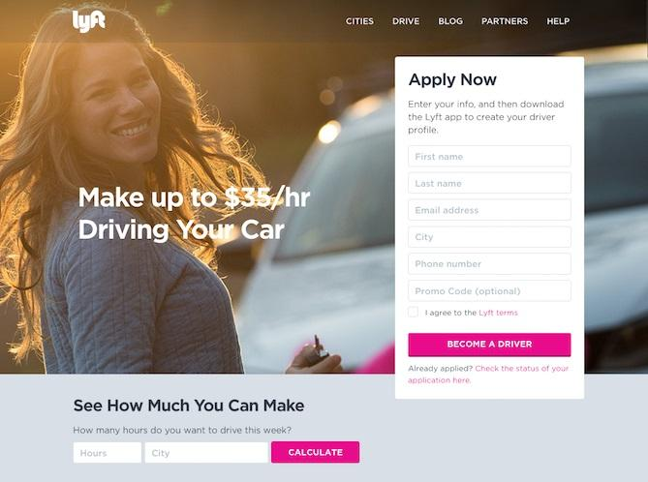
The template we’re inspired by
We’ve been inspired by those two sources , and we also added some edits through discussing with each others as with our tutor.
after sketching over and over we finally came to the final idea.
+
https://www.fod.ma/

Slide 7
The object of our service
this landing page is for our truck japanese food , presenting a discount of 50% .
the user will enter specific informations in order to receive a promo code .
once they get the code they’re ready to visit one of the truck to get the meal the want .

Slide 8

We hope you enjoyed .

